Slide 1
Loadshedding Prediction
Jack Grimston & Hannah Quass

Slide 2
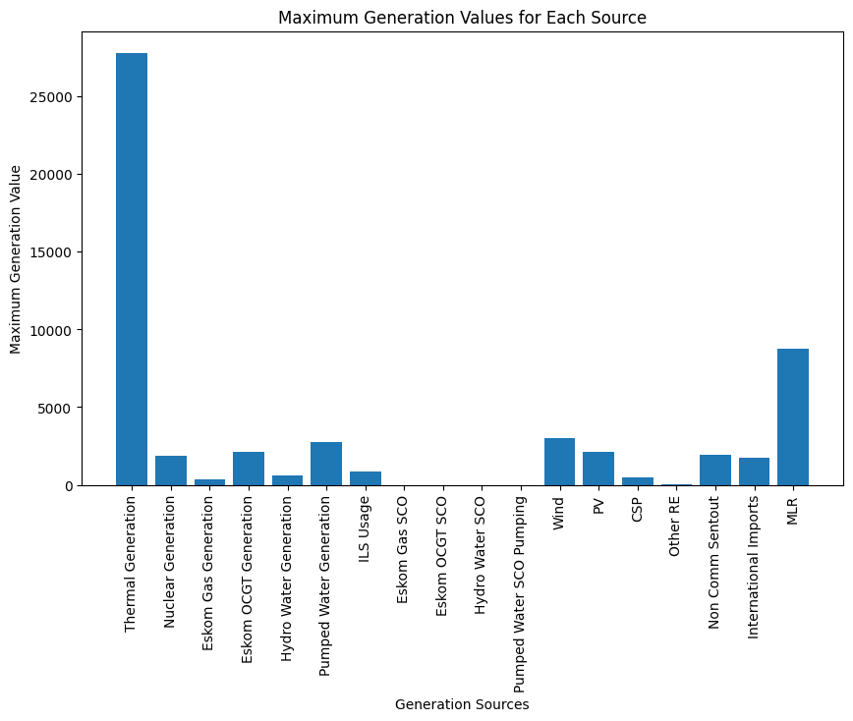
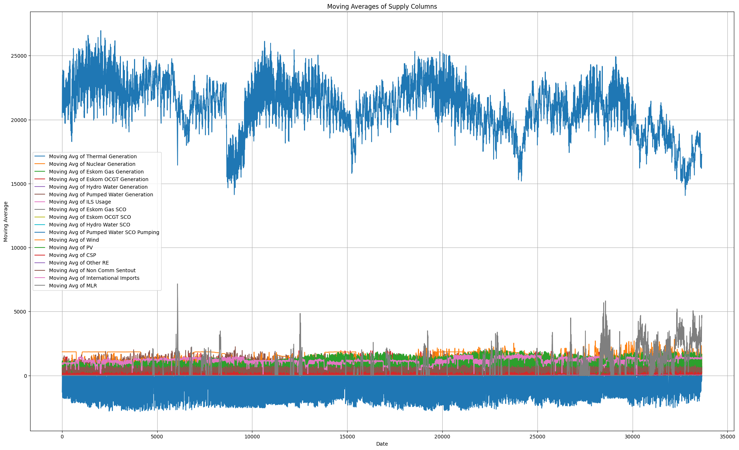
Data Analysis
Most Prominent Electricity resource: Thermal Generation
Moving Averages

Slide 3
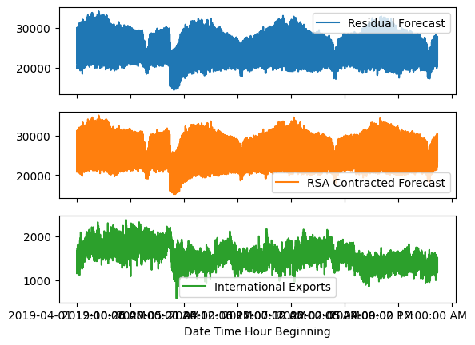
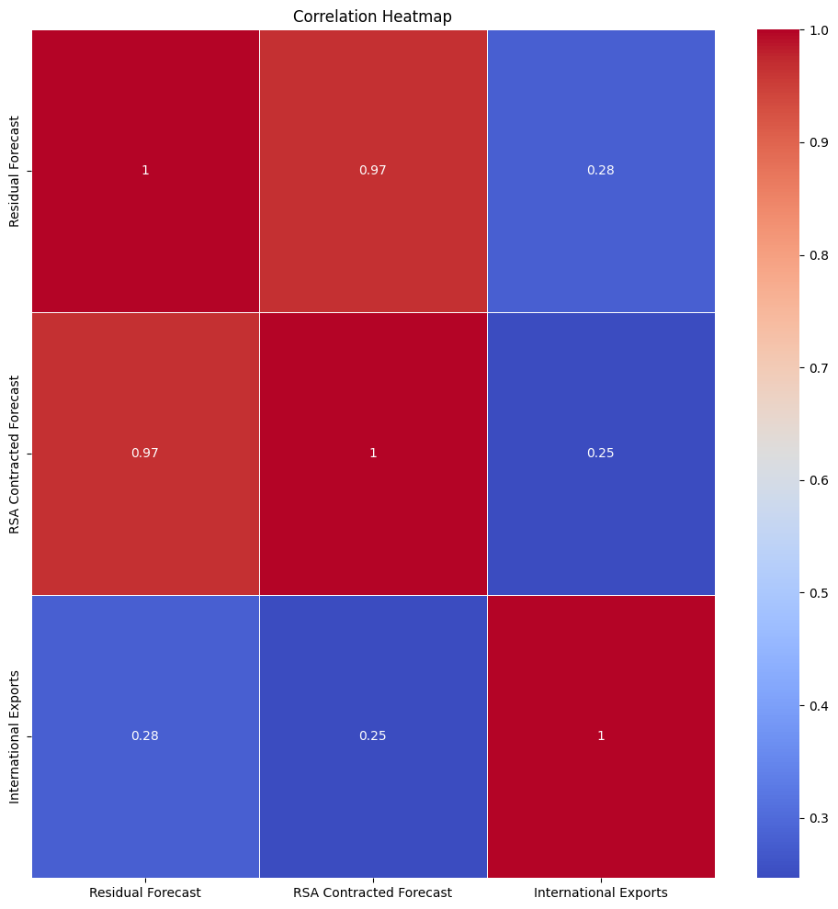
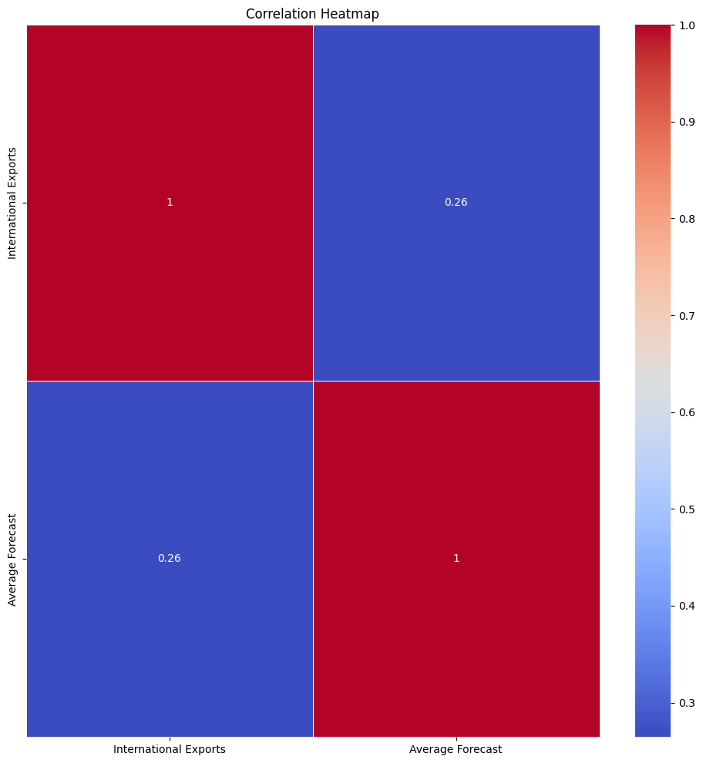
Demand Analysis and Feature Engineering
Notes:
Can see there is common trend with Residual forecast and Contracted forecast
Further shown in heat matrix of correlations
Thus took average of the 2 to create Average forecast

Slide 4
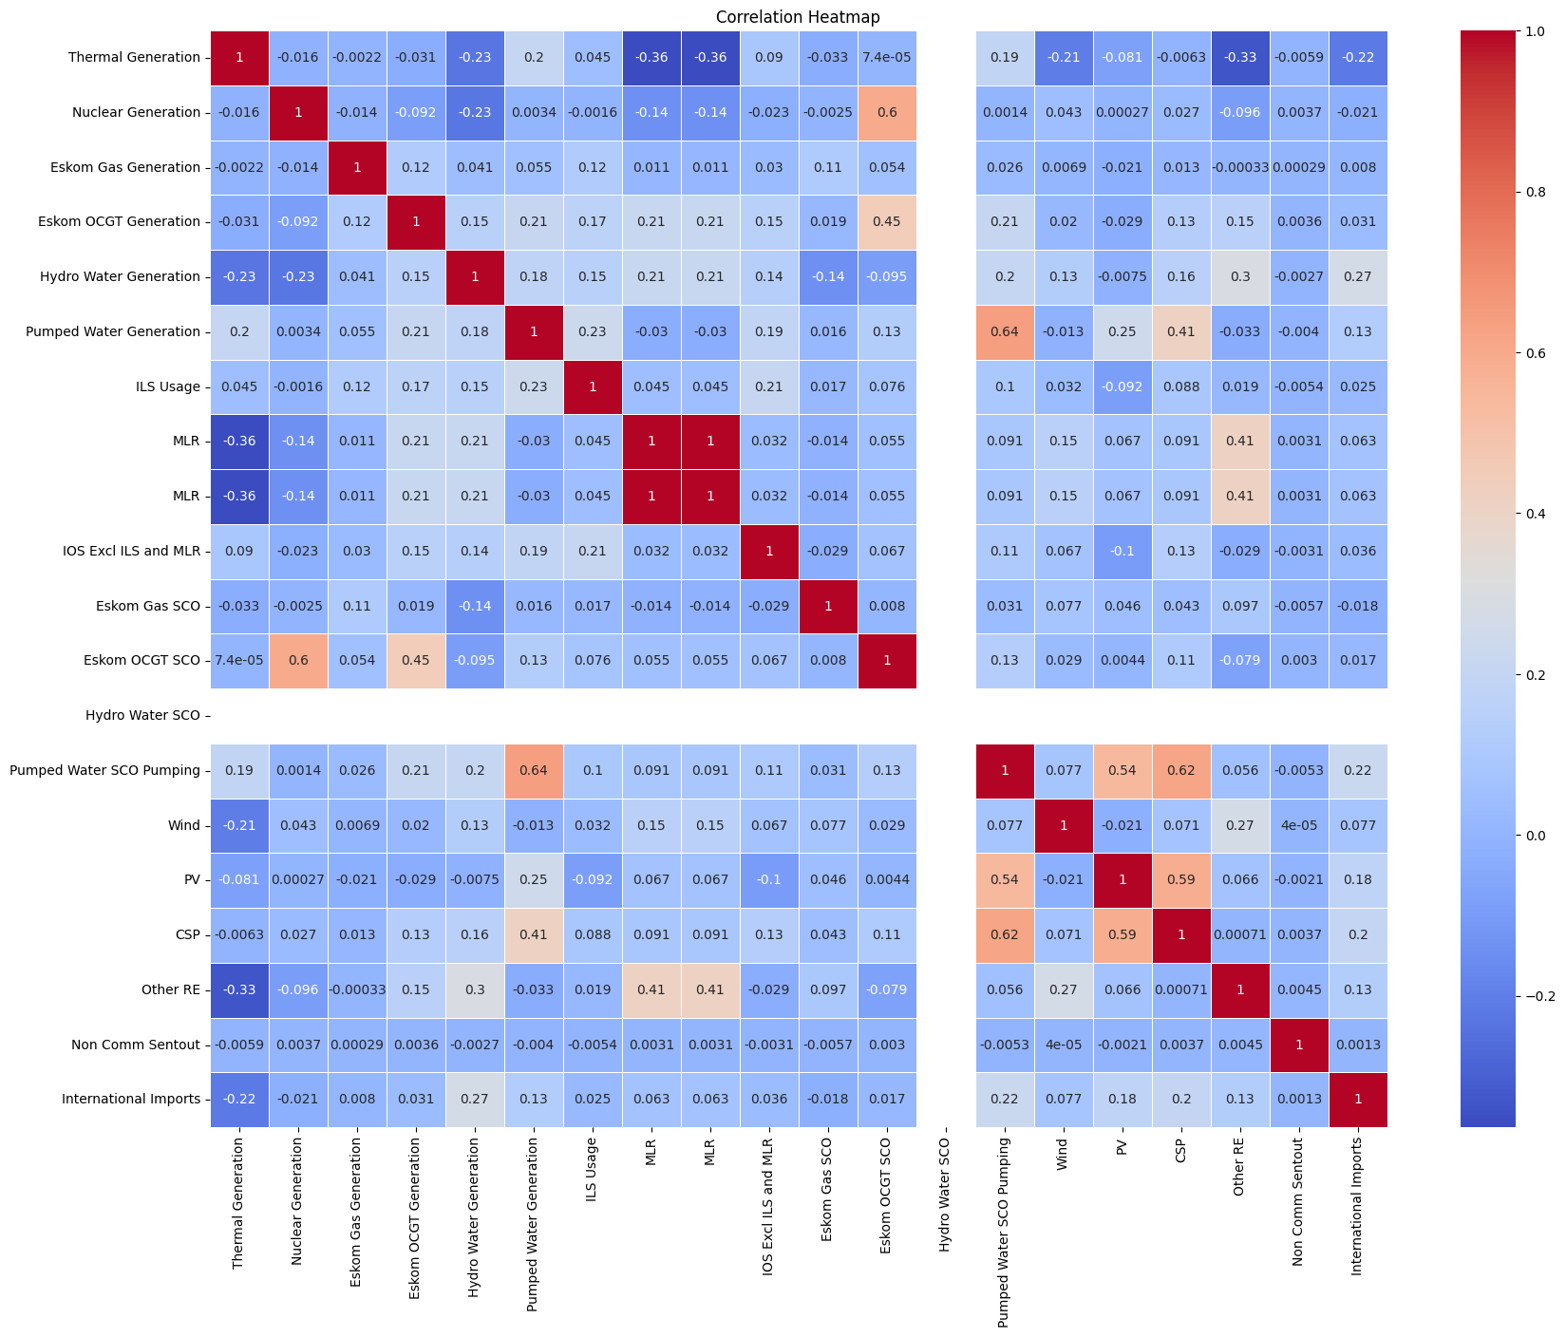
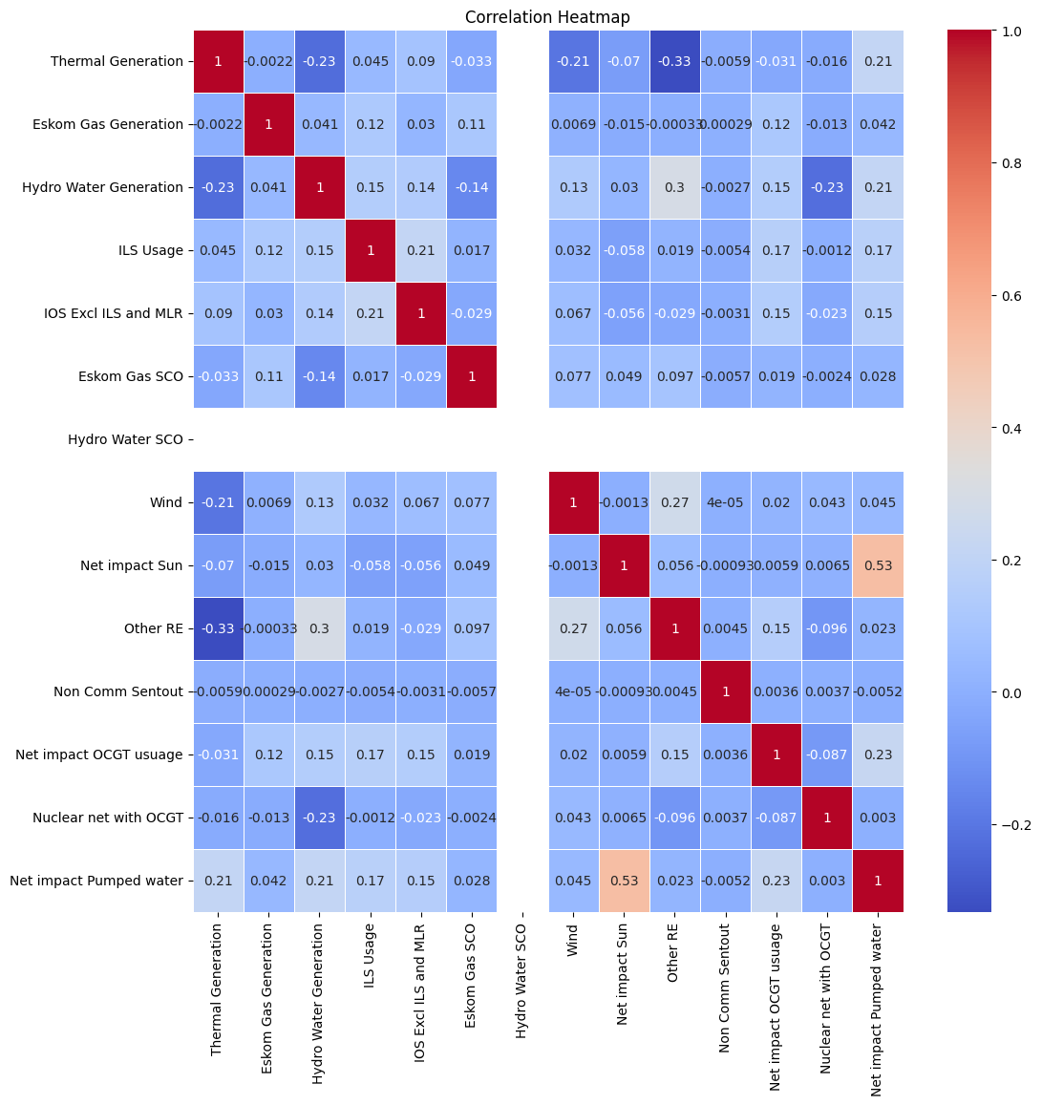
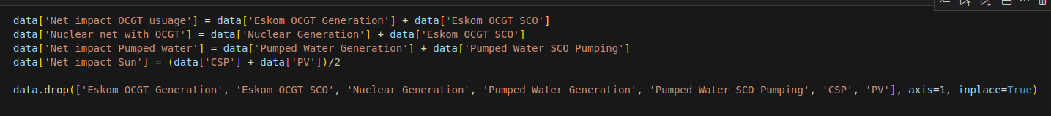
Supply Analysis And Feature Engineering
Notes:
High correlation between many variables: like all the SCO variables and corresponding electricity generation
Took summations and averages of all the electricity resources that share resources: net impact of diesel, net impact of Nuclear, net impact of Pumped water, average of impact of Sun
A lot less correlation, less orange squares - only one left is between solar and water but we believe that this is a weather indicator so leave it as is

Slide 5
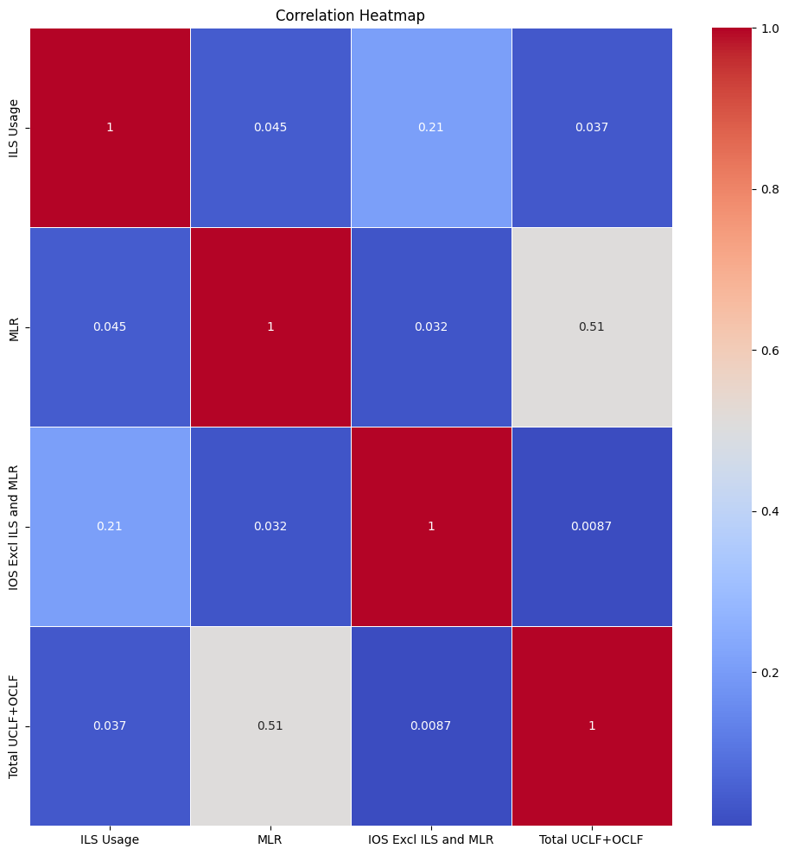
Target Variables
UCLF + OCLF
Total loss of generation capacity due to factors beyond planned maintenance
IOS Exl ILS and MLR
Interruption of supply excluding ILS and MLR
ILS
Forced reduction of usage for Large Firms
MLR (Loadshedding Result)
Demand reduced due to Loadshedding
Notes:
ILS: basically large firms are forced to lower their electricity usuage (contractual agreement) => Eskom will tell them to do this if the System is in large strain

Slide 6
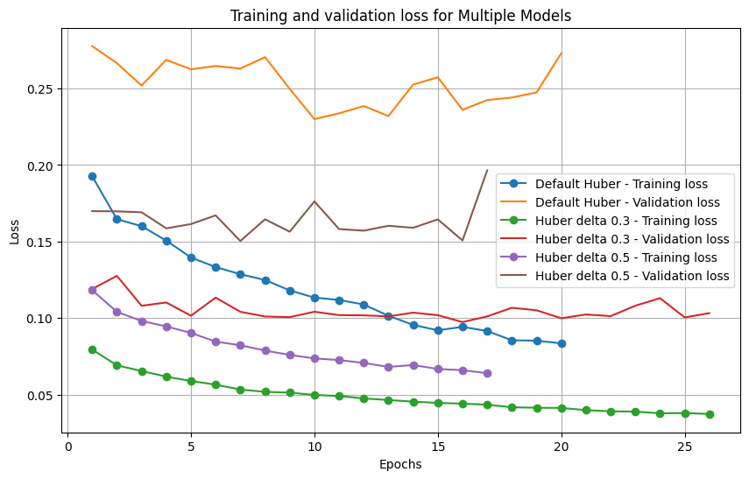
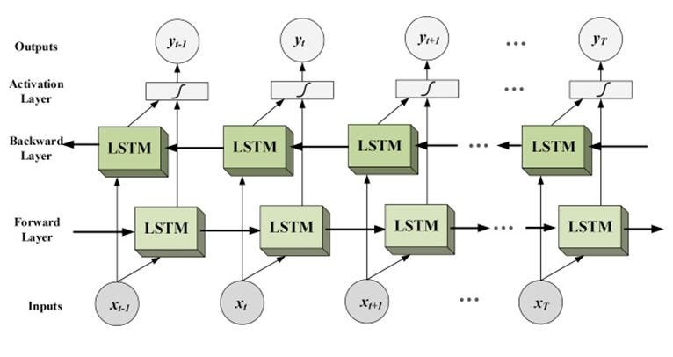
Base Model
Notes:
Unlike traditional LSTMs, a bidirectional LSTM processes input data in two directions: from the beginning to the end (forward) and from the end to the beginning (backward). This allows the model to capture both past and future context when making predictions, which is crucial for understanding behavioral patterns.
We found that a huber value of 0.3 was best, this distinguished the point where the loss is calculated via MAE instead of MSE ()
We found early on that the Huber loss function for fitting is significantly better than the MAE: where the Huber loss is :
The Huber loss function is a type of loss function used in machine learning and optimization tasks, including regression problems. It is designed to be less sensitive to outliers than the mean squared error (MSE) loss function.

Slide 7
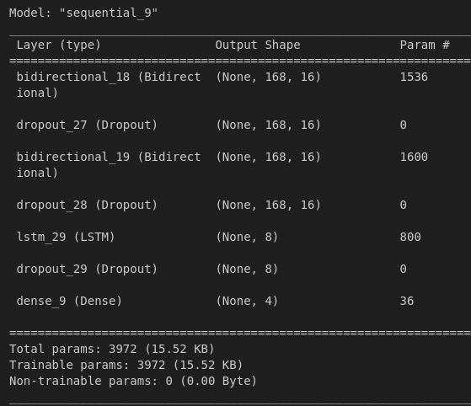
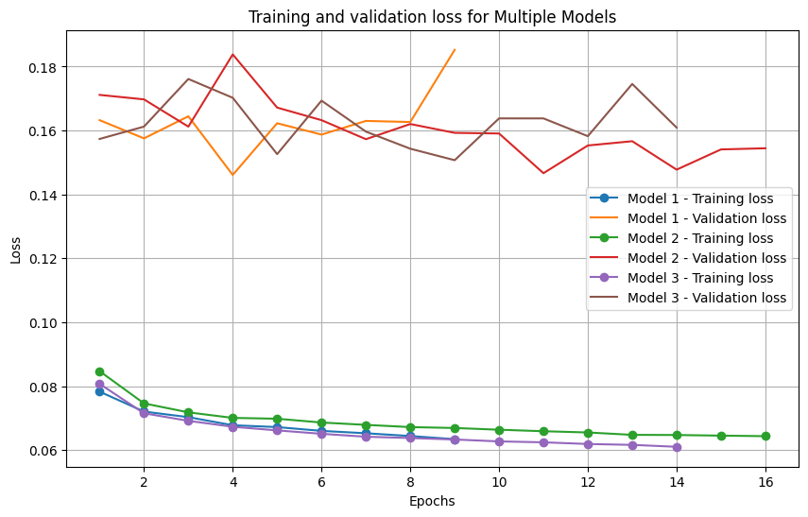
Architecture of Final Model
Notes:
Found that having 8 nodes in each unit with a dropout of 0.2 was best
This was in order to reduce overfitting which is seen in the image to still be prevalent
Nature of deep Bidirectional LSTM is likely to drastically overfit
The model we chose is the line that goes the furthest ie model 3 -> Training error is a little higher than the others but the validation error (also Huber loss) was a lot more stable than the other models we tested
These models included playing around with weight decay and learning weight

Slide 8

Conclusion
Notes:
Yes the word loadshedding scares us all, we were unable to get enough data to map the grid health values to the loadshedding stages (less than 800 valid observations vs 30 000 grid health indicators)
However with further collection and resource allocation optimisers using reinforcement learning - we would be able to find the optimal allocation of electricity resources needed to end loadshedding for good

